Slide 1
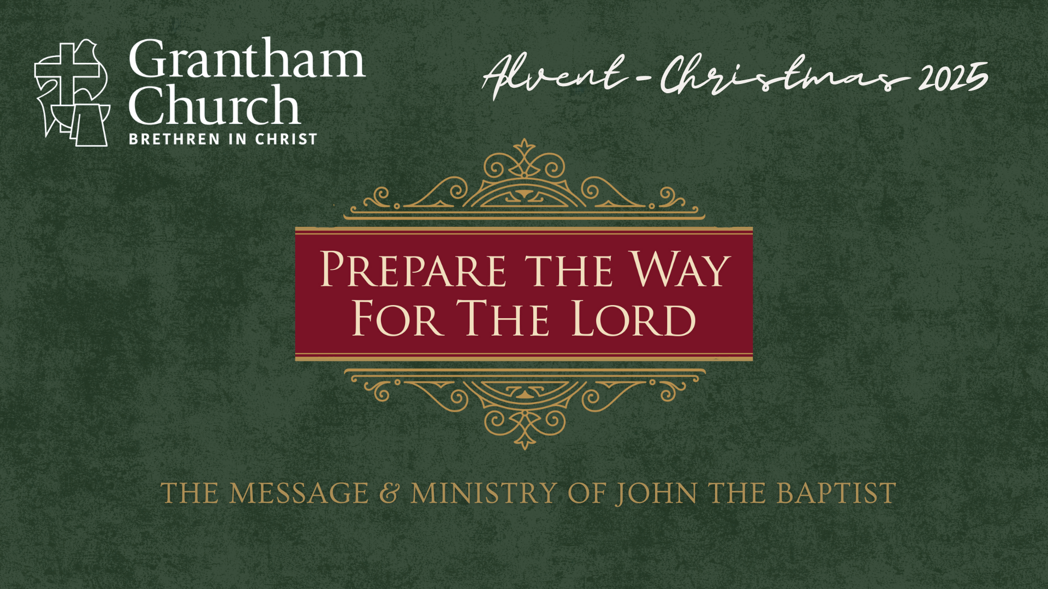
Notes:
[SHOW VIDEO CLIP]
[BRIEF INTRO]
Michael York playing John the Baptist (1977, Jesus of Nazareth)
We can see John’s wilderness attire (like Elijah) and hear his bold, fiery message
This Advent season we’re in a series on John the Baptist—the prophet who prepared the way for Jesus’ coming. Through his message of repentance, grace, and renewal, we’re looking at what it means to prepare our hearts for Christ’s arrival and to live as witnesses of his light.
Two weeks ago, we began our series with an introduction to the message and ministry of John the Baptist, and with an invitation to prepare our hearts for the coming of the Lord as we journey through Advent to Christmas. Last week we went back to the beginning of John’s story and saw God’s grace at work in the life of his parents, Zechariah and Elizabeth. And now for the third Sunday of Advent, we turn our attention to John’s prophetic call to repent, to turn around, and to change our hearts, in a message entitled… [NEXT SLIDE]

Slide 2
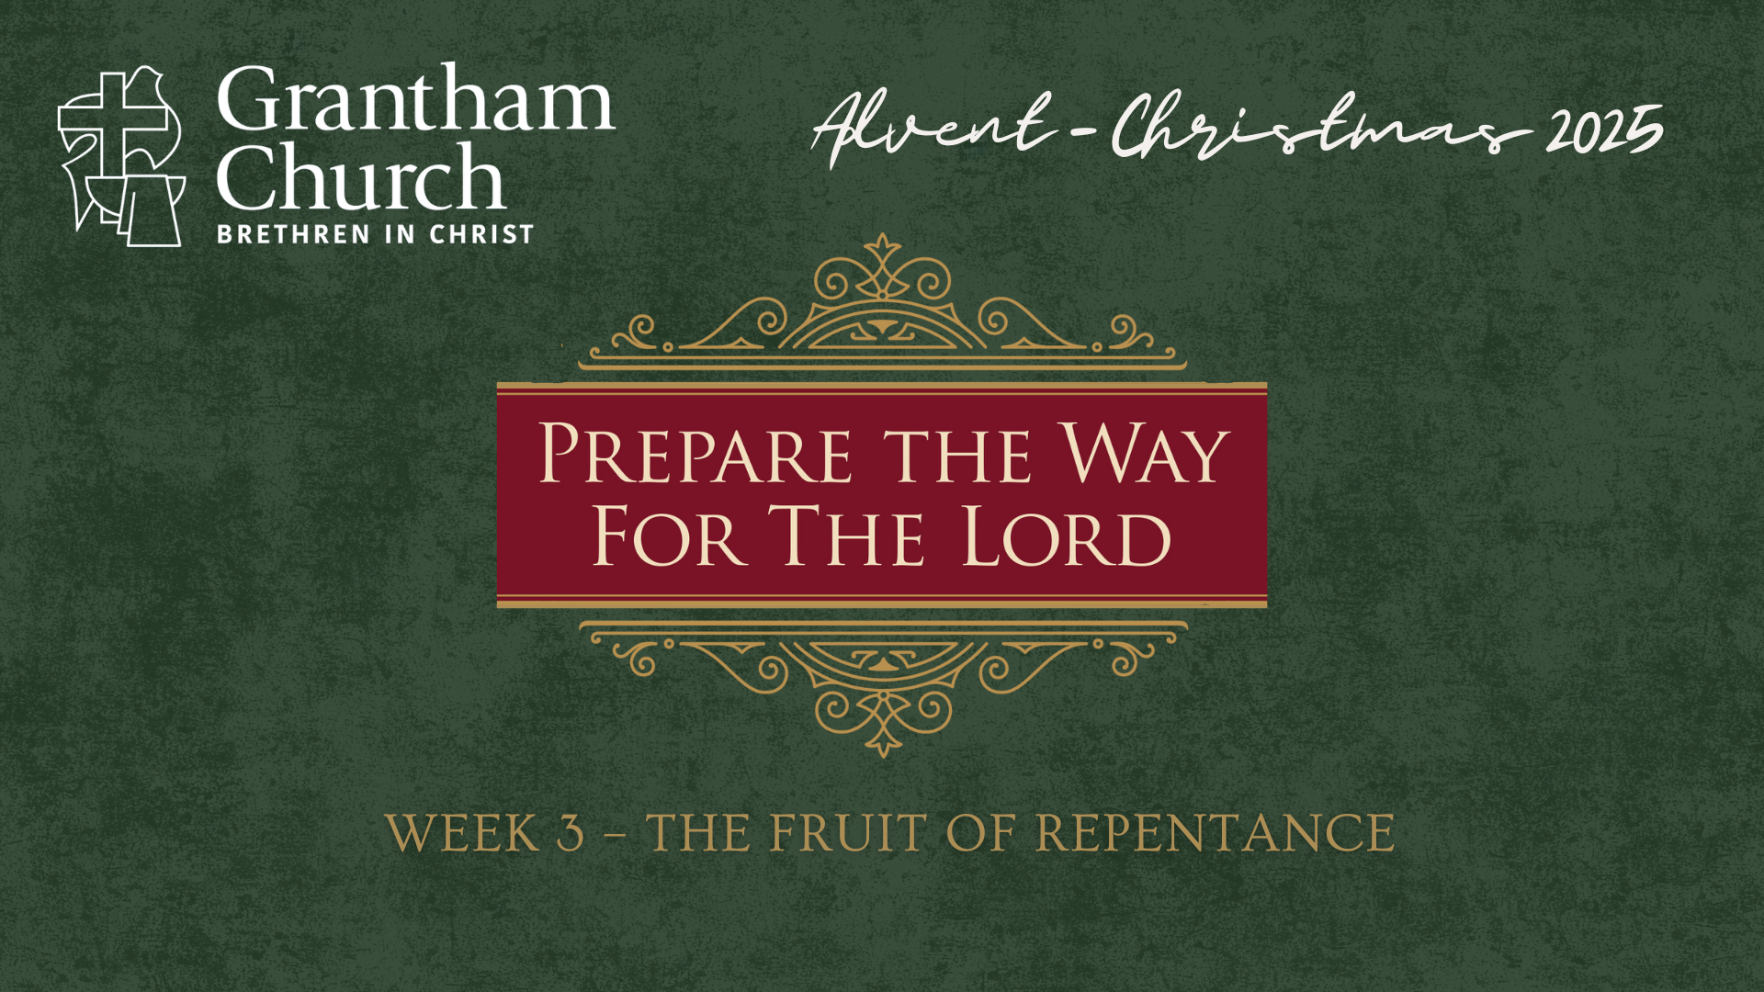
Notes:
The Fruit of Repentance.
According to the message and ministry of John the Baptist, true repentance bears visible fruit (or evidence) and it’s demonstrated by us turning away from sin and doing good works. When we truly repent, there will be noticeable differences. And so, as we listen carefully to the words of this prophet who prepares the way for Christ, we will hear John call for ethical transformation—sharing, fairness, integrity, generosity, and justice. Because Advent is not only about waiting for the Savior but choosing to live like citizens of his kingdom now.
Please open your Bible to the Gospel of Matthew… [NEXT SLIDE]

Slide 3
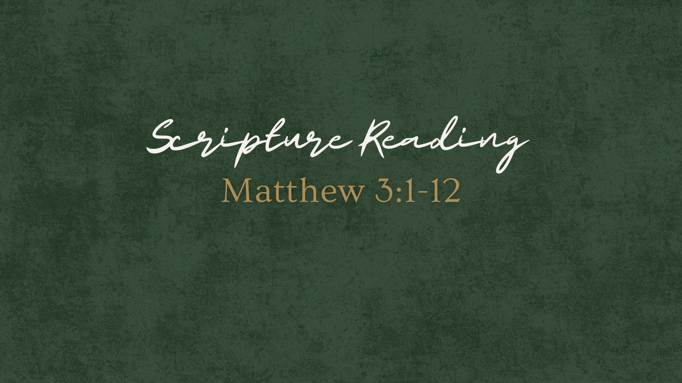
Notes:
[INVITE PEOPLE TO STAND & READ MATTHEW 3:1-12 NIV]
This is the word of the Lord. Thanks be to God. You may be seated.
Remember, as I said in the first week of our series… [NEXT SLIDE]

Slide 4
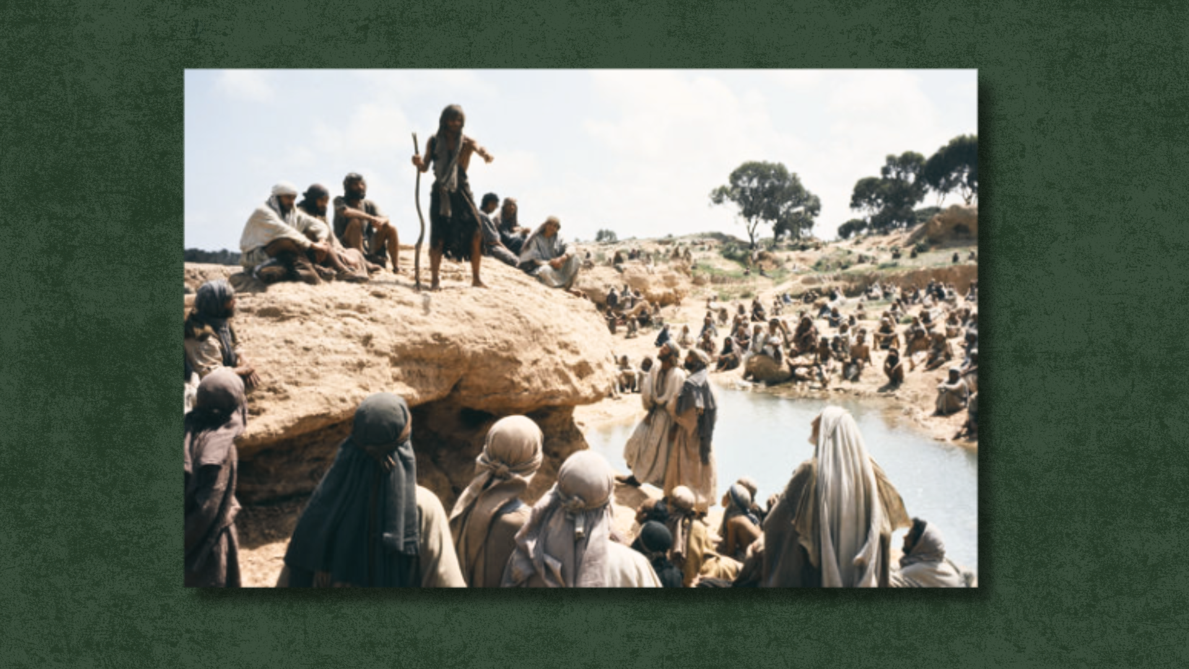
Notes:
Just like an imperial messenger would go out ahead of royalty, John the Baptist sees himself as the one who is to announce the coming of the true King of Israel—the Messiah, the Son of God. In the OT book of Exodus, the wilderness is where the people of God escape to from Egypt—from oppressive empire. It’s a retreat from the hustle and bustle of society, from the idols of empire, and from the slavery of the work week without a Sabbath. And in this new exodus (symbolized by John preaching and gathering people to be baptized in the wilderness), God’s covenant people must pass through the waters of the Jordan—the waters of cleansing, purification, of surrender, and of salvation. And so, the baptism given by John symbolized God doing a new thing and preparing his people to enter the promised land and follow the way of the Messiah.
And John, who had some hard things to say to the religious leaders, said that the coming Messiah would baptize with fire and separate the good from the bad. What does he mean? When John says that Jesus will baptize with fire, he means that Jesus will immerse people in God’s holy presence—a presence that purifies the repentant and exposes and judges what is evil. And so, people need to get their hearts right, for God is on a rescue mission and is calling all people to himself. Listen to what Adam Hamiton writes in his book… [NEXT SLIDE]

Slide 5
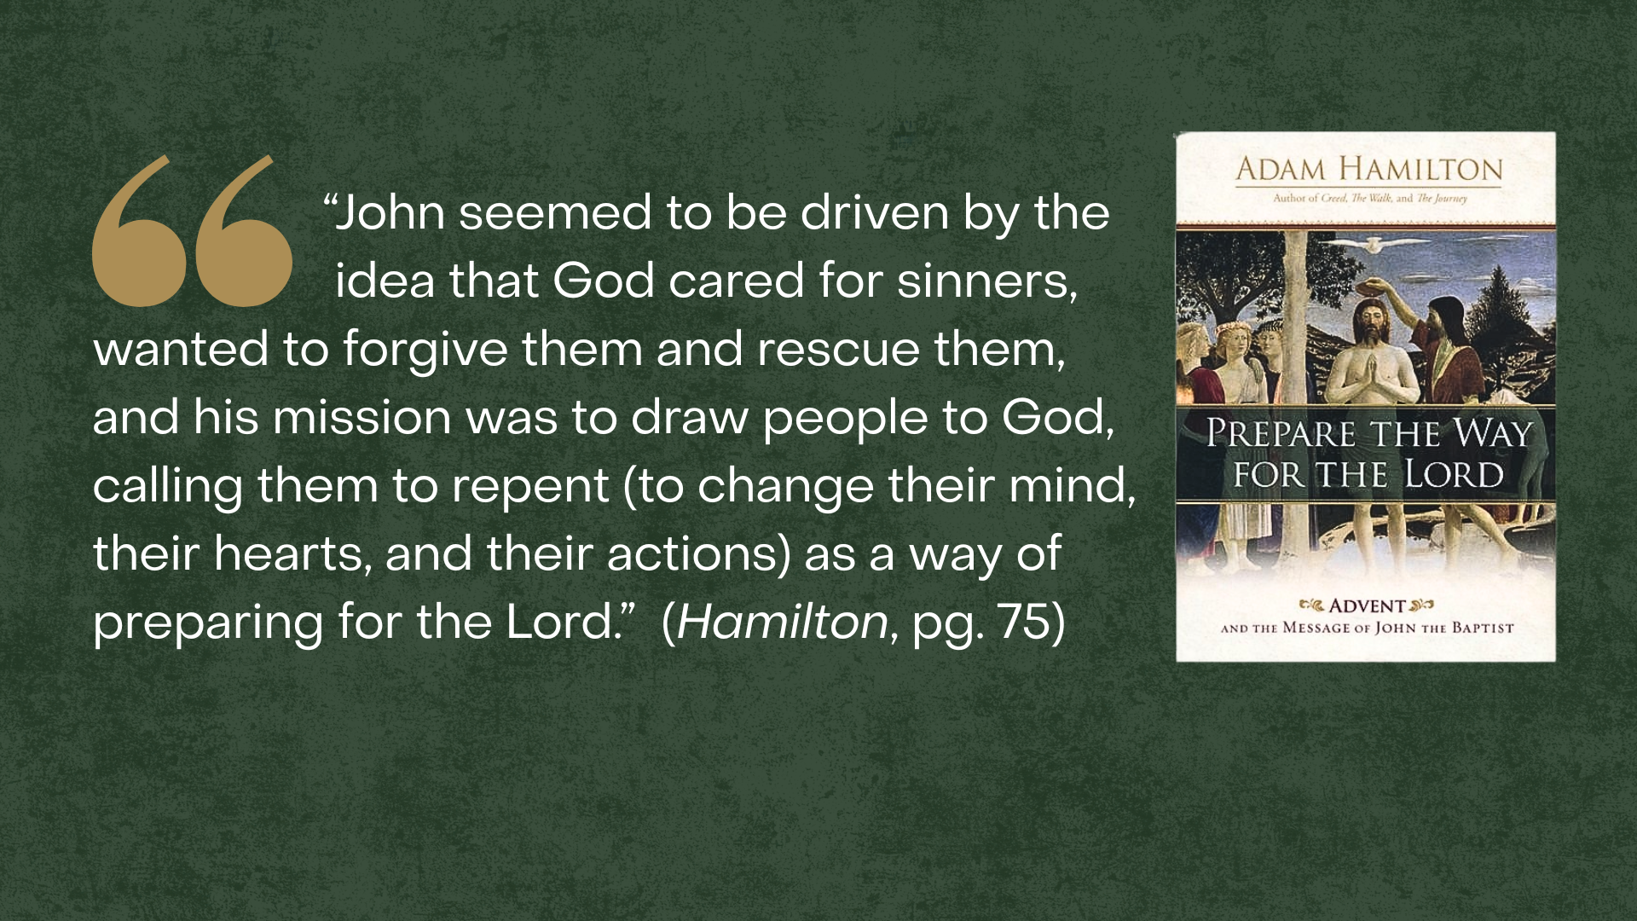
Notes:
[READ QUOTE & COMMENT]
And what does this repentance and preparing for the Lord look like? Well, that’s what John’s original audience asked as well. Luke 3, verses 10-14, the crowds asked… [NEXT SLIDE]

Slide 6
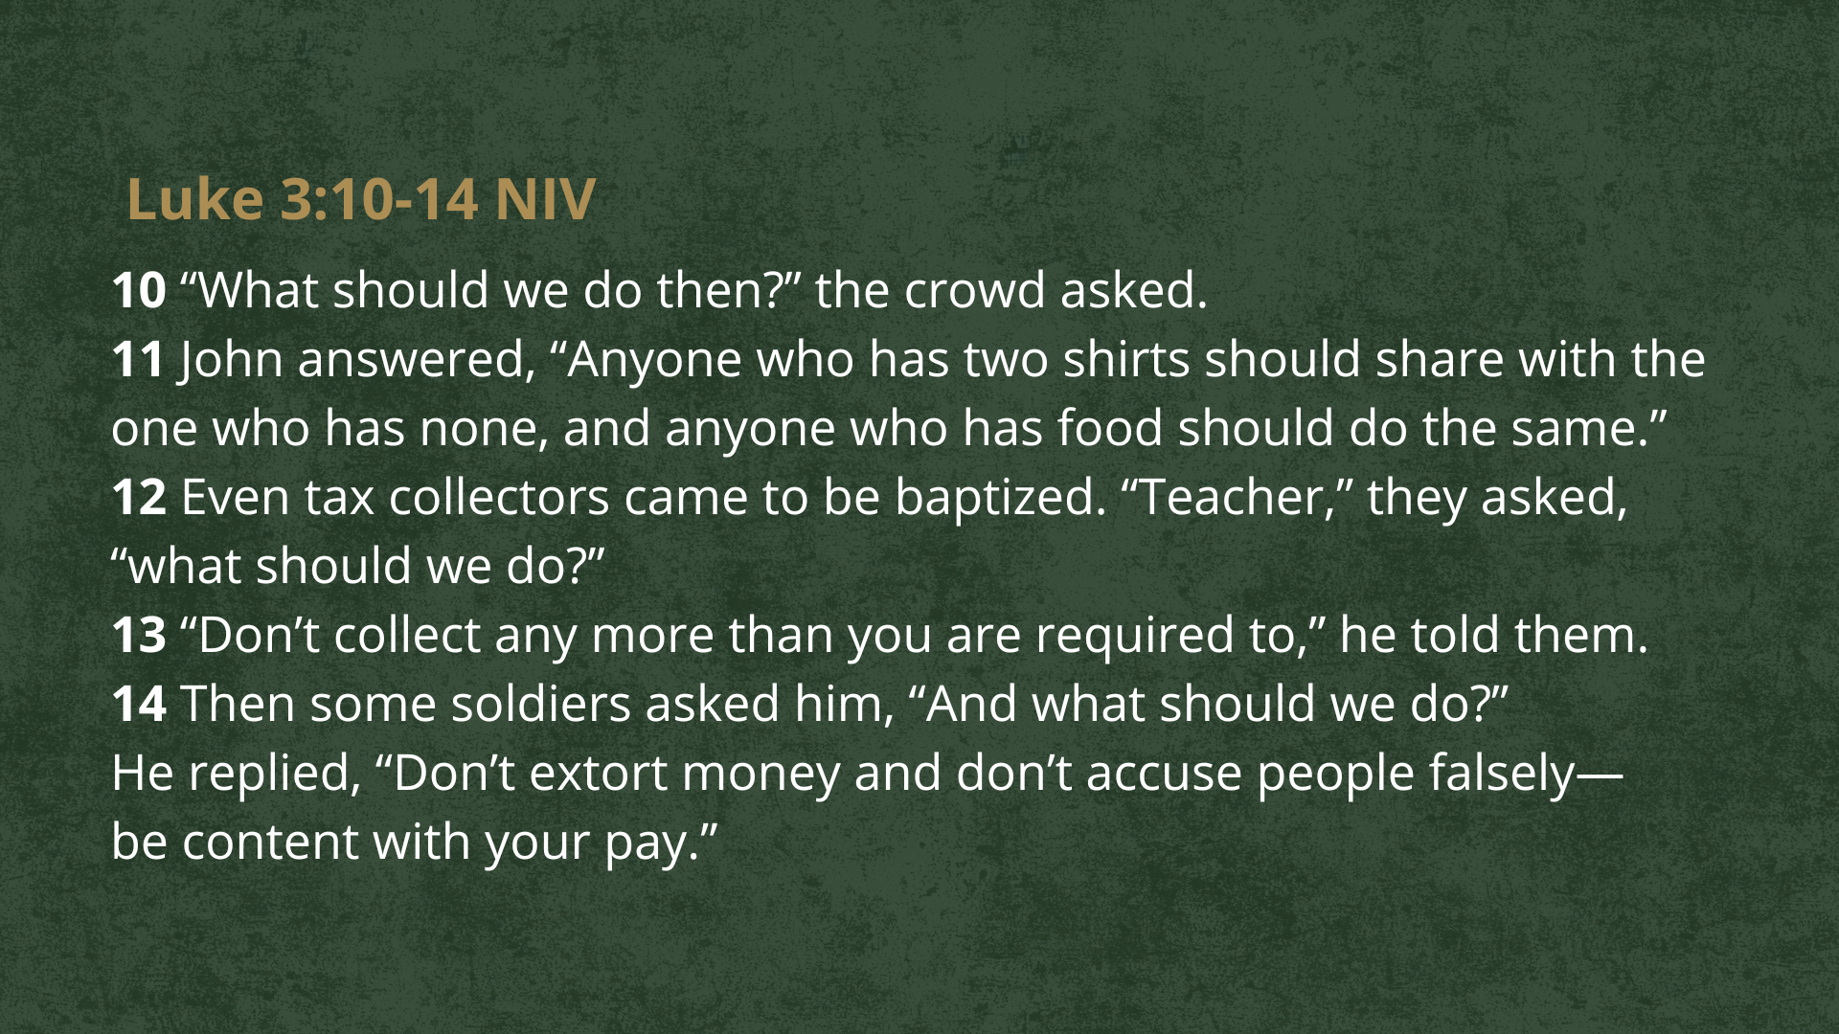
Notes:
[READ PASSAGE & COMMENT]
It’s important to understand that John’s message is new in that he is explicitly saying that the Messiah is coming, get ready! But his message is also an old one in the sense that the OT prophets before him said similar things when calling the people of God to repent.
For example, listen to what God said through the 8th century prophet Amos… [NEXT SLIDE]

Slide 7
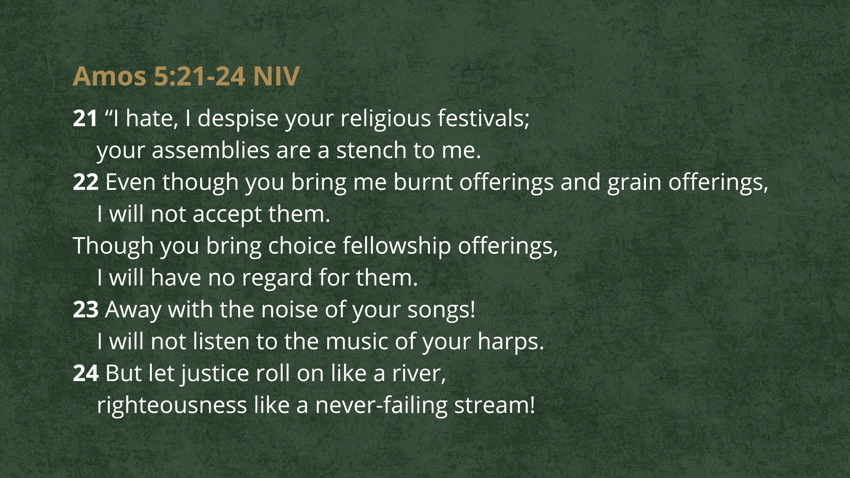
Notes:
[READ & COMMENT]
Now, keep in mind that Amos prophesied during a period of political stability, economic prosperity, territorial expansion, and military strength. From the outside, everything looked blessed. The nation assumed God was pleased with them because life was comfortable and successful. But underneath the prosperity, the nation was rotting.
And so, in Amos 5:21–24, God rejects Israel’s worship because their society was filled with injustice, the powerful exploited the poor, the courts were corrupt, their religious practices masked moral decay, they confused prosperity with divine approval, and they worshiped God with their lips while violating His covenant with their lives. The passage isn’t about God not desiring our worship—it’s about covenant faithfulness—it’s a radical call to integrate justice and righteousness (i.e., how we love God and our neighbor) into the life of the community.
And then there’s the prophet Micah, who ministered in the late 8th century BC during a time of national anxiety, corruption, and looming judgment. He wrote these familiar words… [NEXT SLIDE]

Slide 8
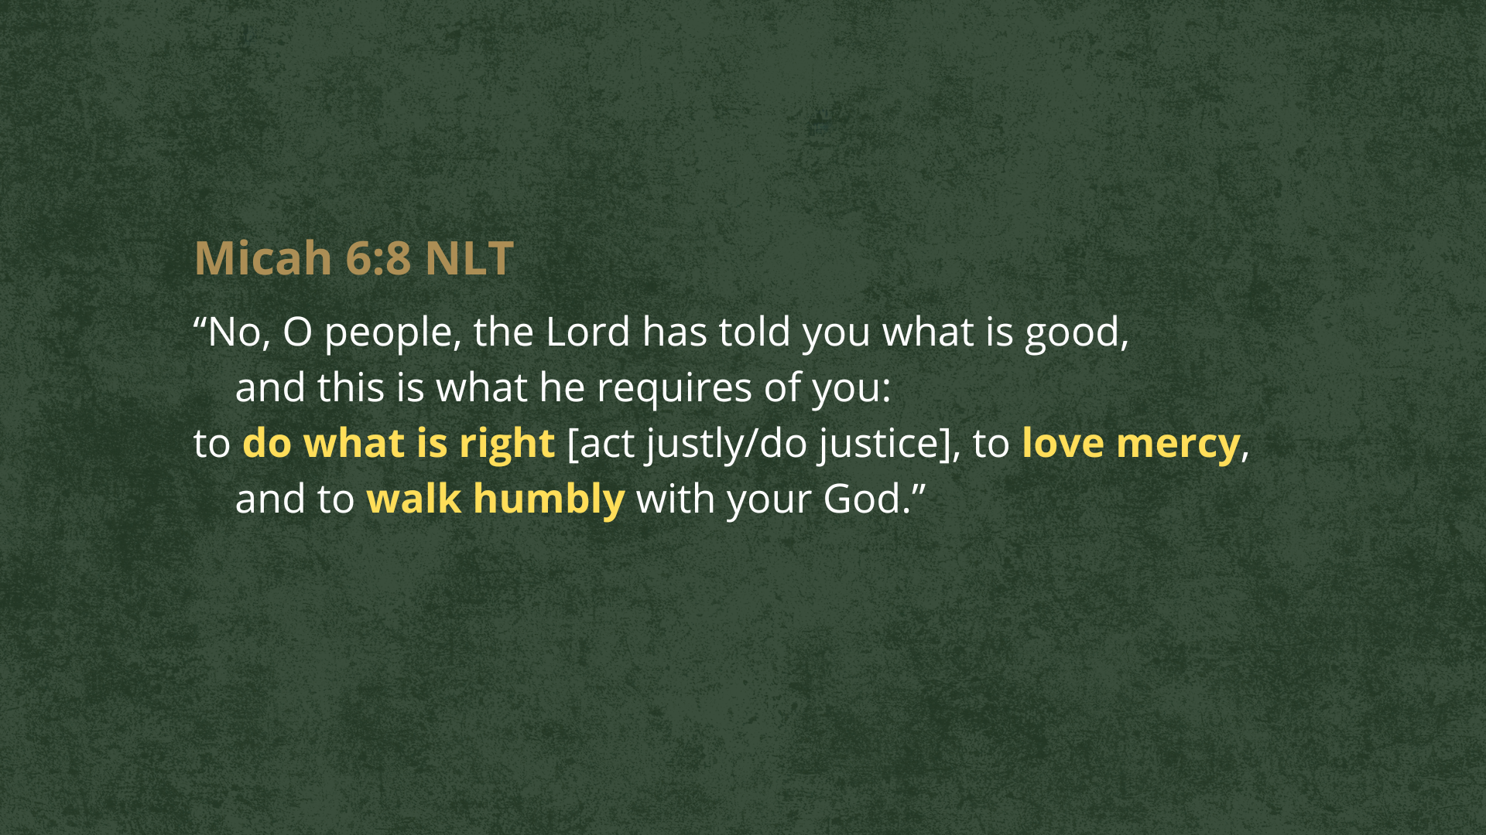
Notes:
[READ & COMMENT ON PASSAGE]
Micah 6:8 arises from a time of political turmoil, social injustice, economic exploitation, and superficial spirituality; it is God’s call for His people to return to covenant faithfulness through justice, mercy, and humble obedience—virtues they had abandoned. And like Amos, the prophet Micah exposed Israel and Judah for trusting in ritual performance rather than covenant obedience. So, Micah is saying, what God really wants is for you to:
Act justly - live with equity, fairness, honesty; protect the vulnerable.
Love mercy - practice forgiveness and reflect God’s grace and love.
Walk humbly with your God - live dependently, faithfully, and obediently before God.
It’s a call to return to the heart of Israel’s identity as God’s people. And while Micah proclaimed God’s judgment on the idolatry, injustice, and spiritual apathy of God’s people, he also promised a coming shepherd-king (Micah 5:2–4), a future restoration, and a remnant who returns to covenant faithfulness. Therefore, Micah 6:8 stands at the hinge of judgment and hope, summarizing what God desires from His people. And this is what John the Baptist is evoking in their memory and calling us to do today, as we prepare the way for the Lord.
Let’s sum up this message of repentance like this… [NEXT SLIDE]

Slide 9
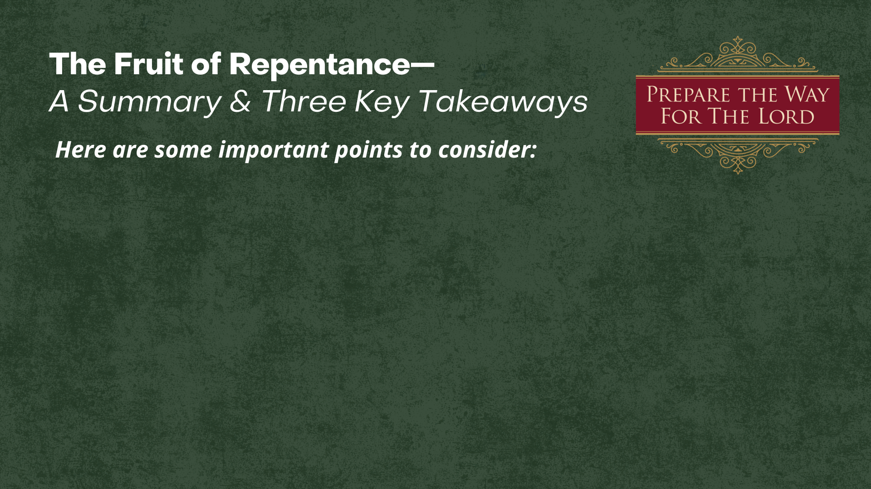

Slide 10
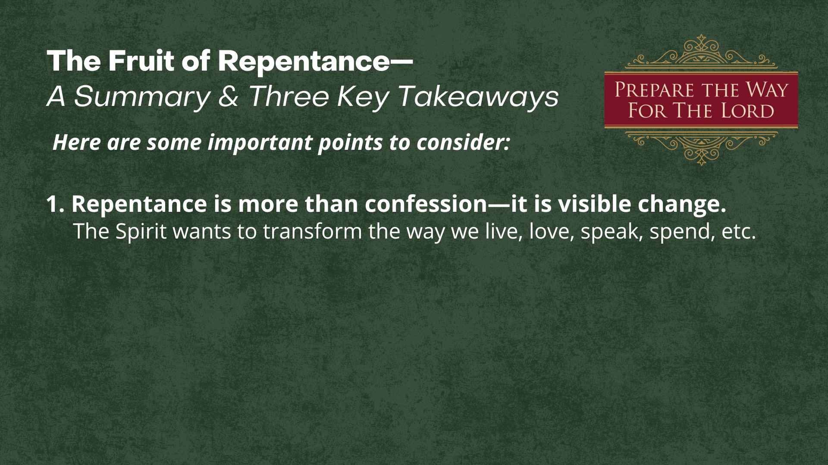

Slide 11
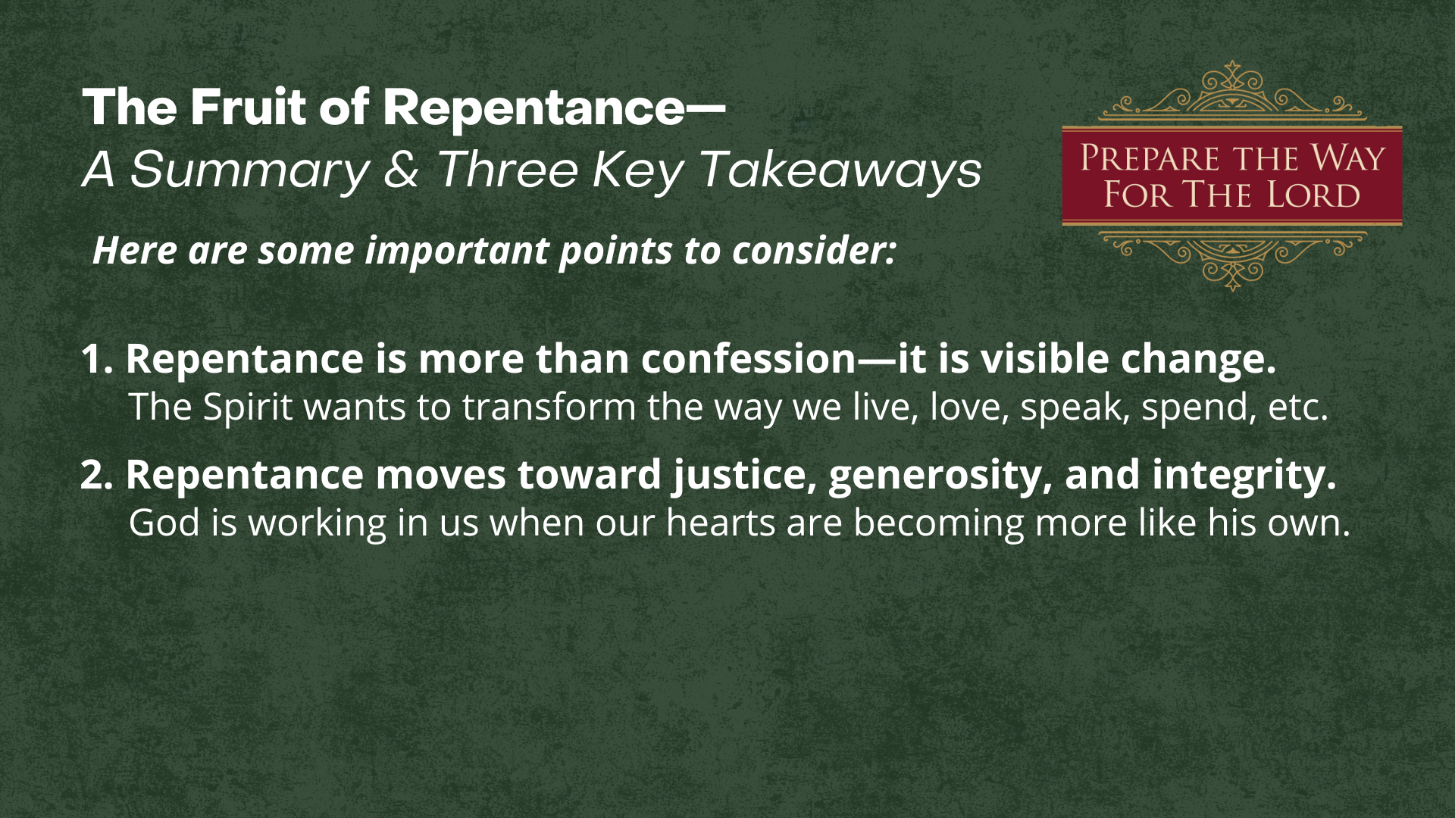

Slide 12
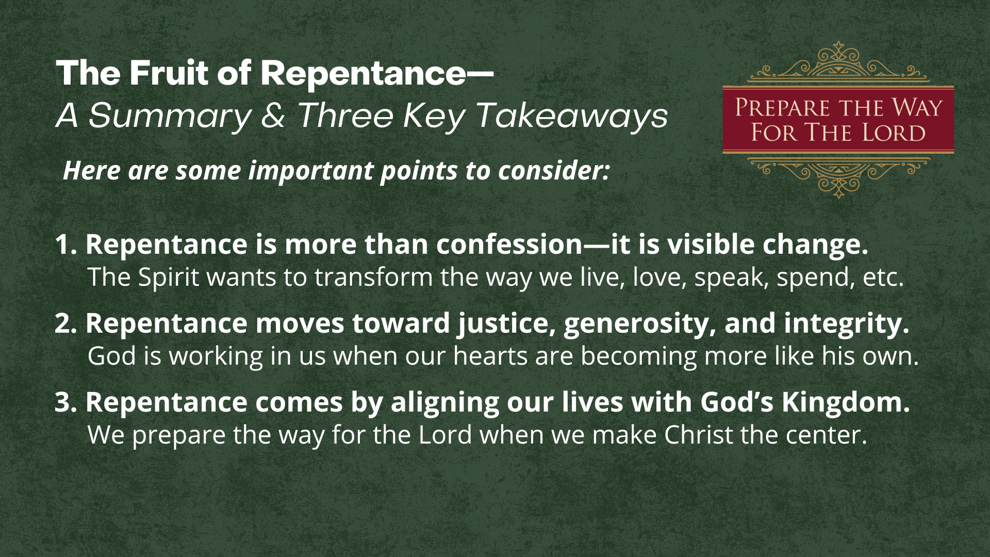
Notes:
[READ TAKEAWAYS & COMMENT BRIEFLY]
1. Repentance is more than confession—it is visible change.
The Spirit wants to transform the way we live, love, speak, spend, etc.
2. Repentance moves toward justice, generosity, and integrity.
God is working in us when our hearts are becoming more like his own.
3. Repentance comes by aligning our lives with God’s Kingdom.
We prepare the way for the Lord when we make Christ the center.
Consider some examples of what this looks like from modern life:
A well-known example is Chuck Colson, once called Nixon’s “hatchet man.” After being convicted during Watergate, Colson experienced a profound conversion. He publicly confessed wrongdoing, accepted prison time, and later founded Prison Fellowship, devoting the rest of his life to serving people he once ignored. His actions—service, advocacy, and humility—showed the fruit of true repentance.
A woman in her 20s shared publicly in her church that she had lived years in alcoholism and relational manipulation. Her repentance wasn’t just an apology—she joined recovery; sought forgiveness from several people she’d hurt; changed her social environment; invited her church community into her healing. For this young lady, repentance took the form of long-term transformation, mentorship, and accountability.
At a youth retreat, a 16-year-old boy confessed to cheating and stealing. His repentance included: returning items, writing apology letters, paying restitution from his part-time job, and meeting regularly with an adult mentor to deepen his faith and form his character.
After years of a pornography addiction and emotional unfaithfulness, a husband confessed to his sins; not after being caught but after experiencing conviction. He initiated counseling, shared his struggles with a small group of guys, and committed to rebuilding trust with his wife and restoring his marriage. Repentance, in this case, was expressed through vulnerability, accountability, removing temptations, and setting boundaries.
And then there was a restaurant owner in Kentucky who became a Christian in midlife and realized he was paying employees unfairly and cutting corners legally. Without being pressured by lawsuits or bad publicity, he voluntarily raised wages, paid back missing overtime, corrected tax practices, and began giving meals away on weekends. It cost him financially, but he called it “setting things right,” language that echoes a familiar story from the Gospel of Luke… [NEXT SLIDE]

Slide 13

Notes:
[READ LUKE 19:1-10 & COMMENT]
Think about how Zacchaeus is a model of repentance that bears fruit:
He welcomes Jesus into his life.
He responds with joy, not mere duty.
He makes specific, practical changes.
He embraces costly obedience.
He actively seeks to heal past wrongs.
His life becomes a testimony to the saving power of Jesus.
My friends, Zacchaeus’s story shows that repentance is not abstract—it’s visible, relational, and transformative, touching both our hearts and our habits. And so, may we hear the call of John the Baptist—and the call of Jesus—as an invitation to welcome more of Christ and his Kingdom into our lives, so that we will know the hope, peace, joy, and love of God this Christmas.
Finally, here are some questions to help us reflect and respond together.… [NEXT SLIDE]

Slide 14
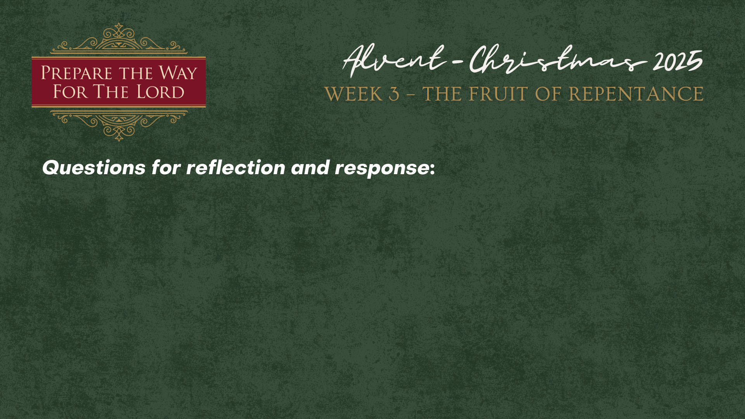

Slide 15
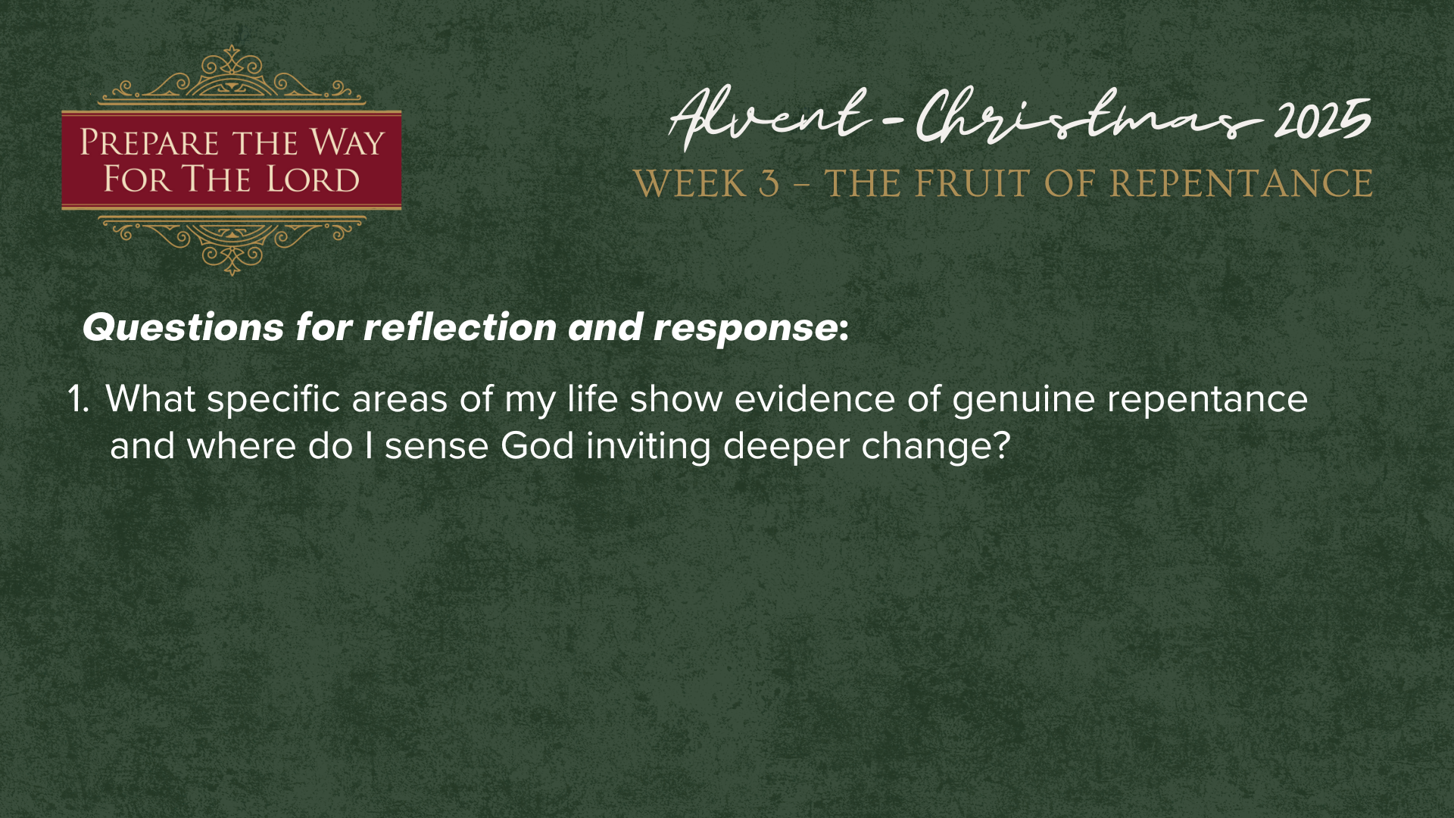

Slide 16
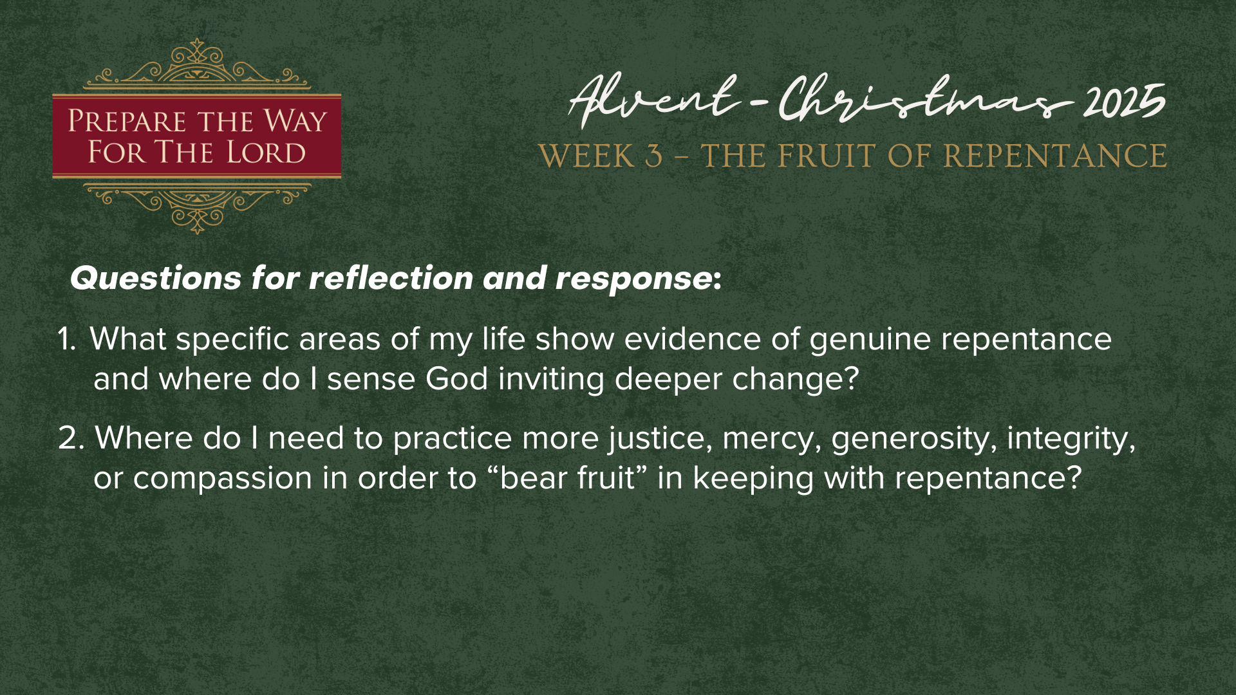

Slide 17
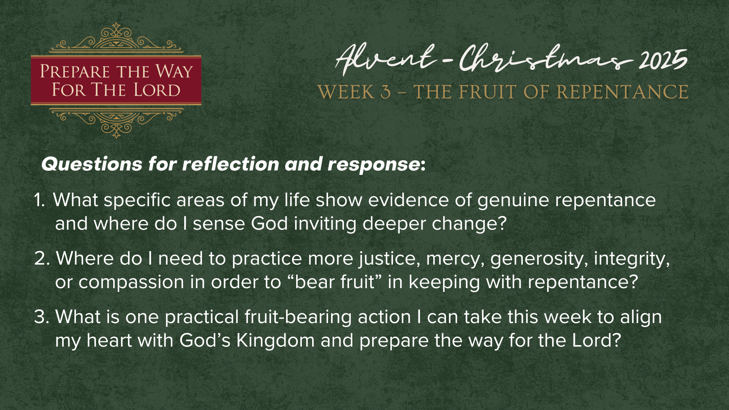
Notes:
[READ QUESTIONS & COMMENT]
What specific areas of my life show evidence of genuine repentance and where do I sense God inviting deeper change?
Where do I need to practice more justice, mercy, generosity, integrity, or compassion in order to “bear fruit” in keeping with repentance?
What is one practical fruit-bearing action I can take this week to align my heart with God’s Kingdom and prepare the way for the Lord?
And to help you that, consider choosing one of these options… [NEXT SLIDE]

Slide 18
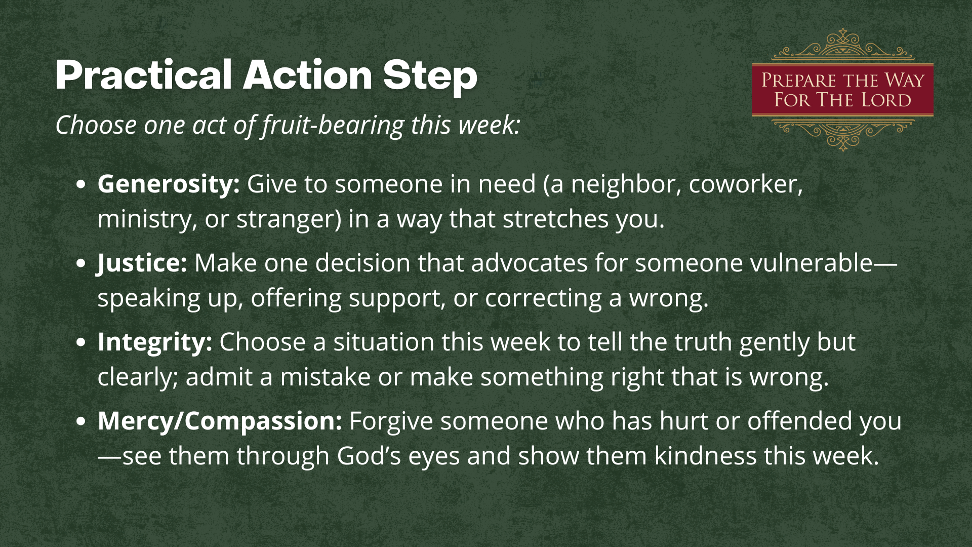
Notes:
[READ SLIDE & COMMENT]
How is the Spirit inviting you to respond? Whatever the Lord is saying to you, let’s commit to it and follow through. The goal is not perfection, but movement—one step that aligns your living with the Kingdom of God and joins your heart with the heart of Christ. This is how we prepare the way for the Lord. This is how we bear the fruit of repentance.
Let’s pray… [NEXT SLIDE FOR CLOSING PRAYER]

Slide 19
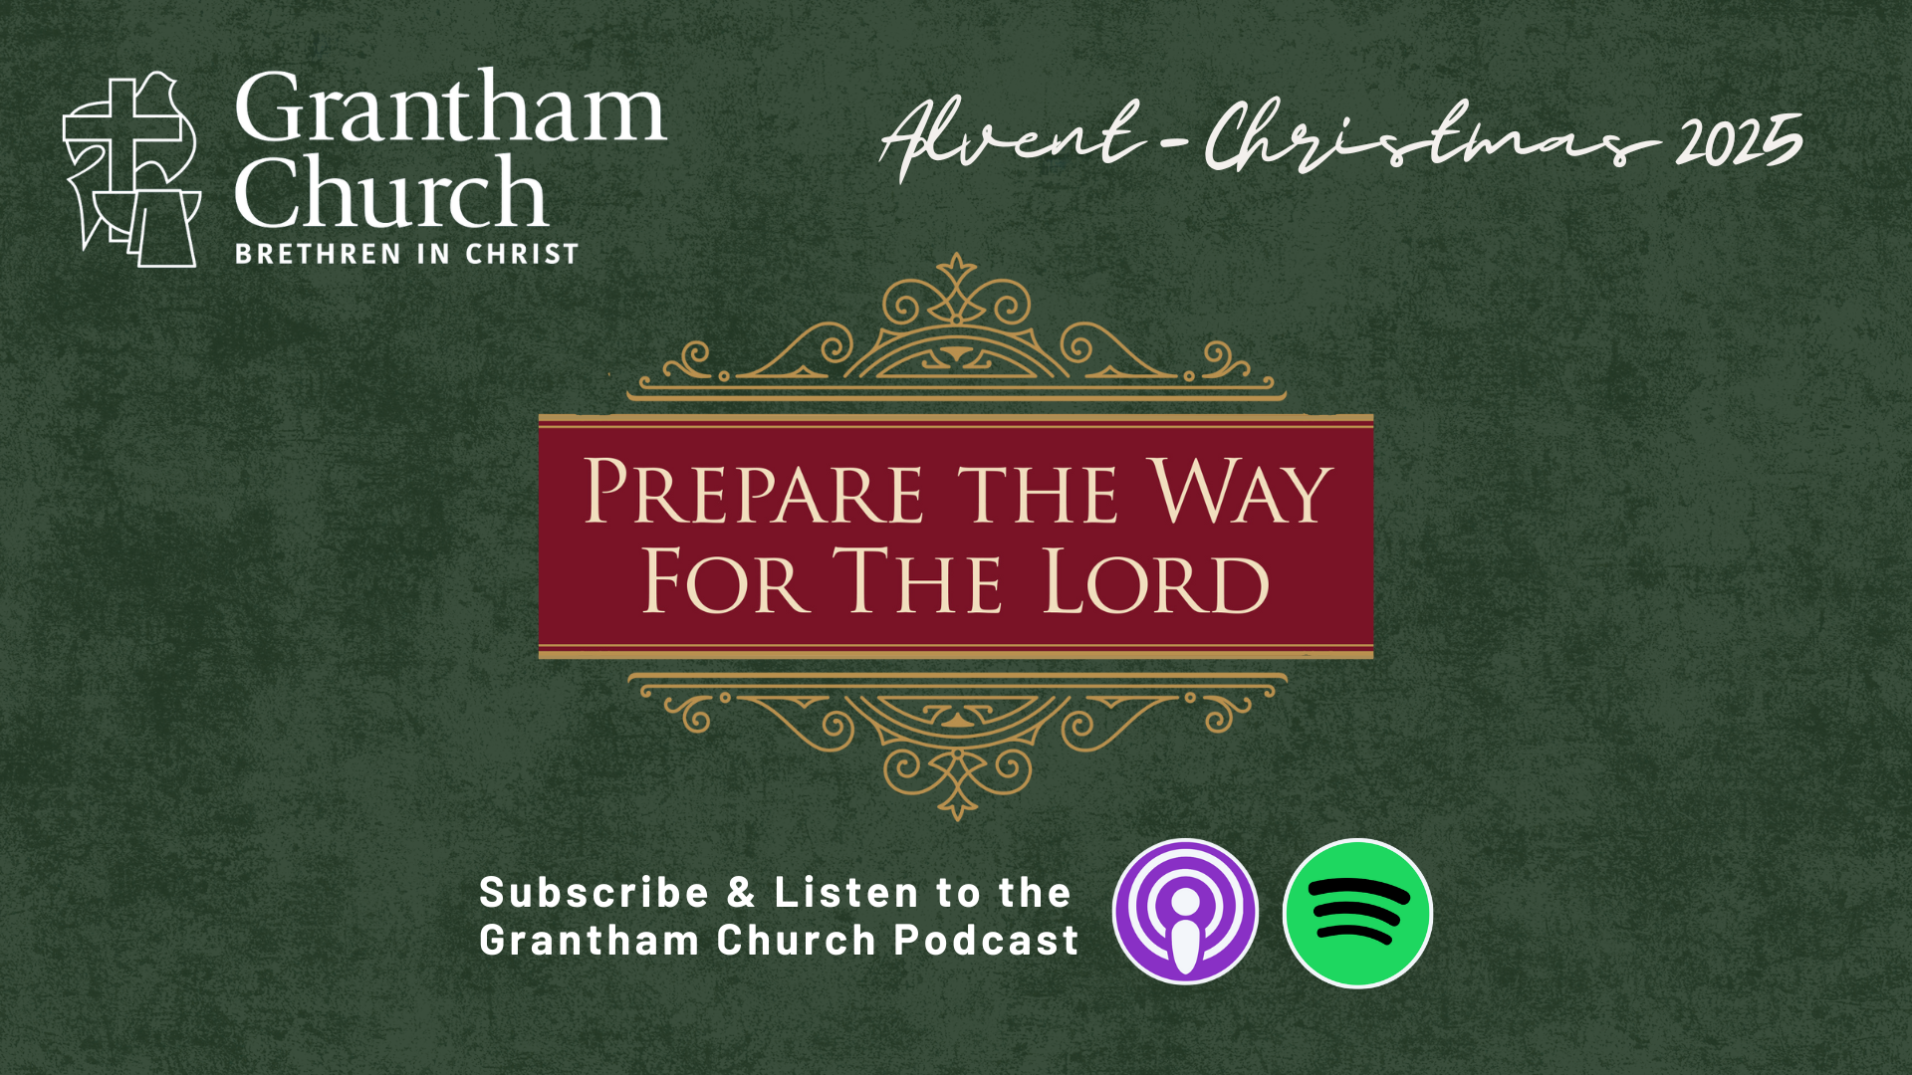
Notes:
[CLOSING PRAYER]
[CLOSING SONG]
Benediction
Go now as a people prepared for the Lord.
Walk in His grace, bear the fruit of His Spirit,
and shine with the light of Christ in all you do.
May the peace of God guard your hearts,
and may Christ increase in you—
today and always.
Amen.

